Slide 1

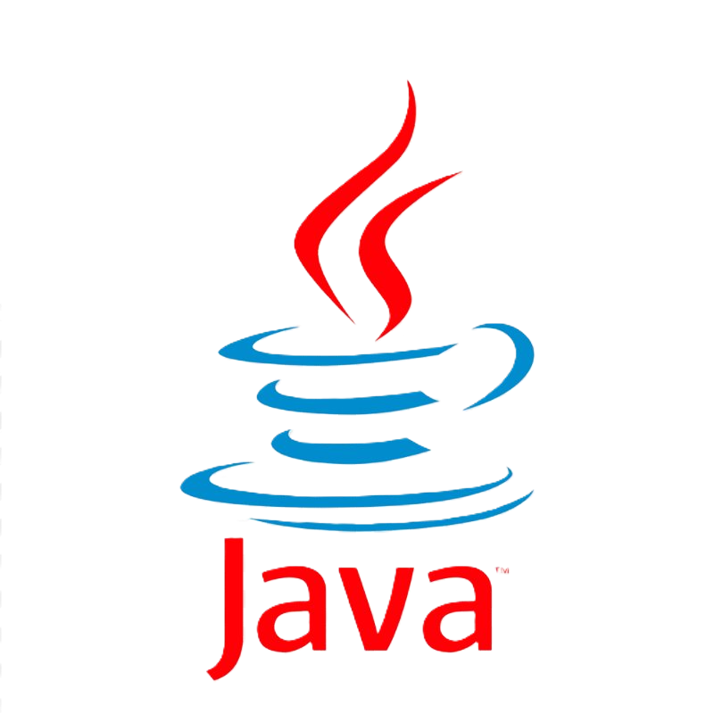
History of Java
Group 8 - Advanced Programming Language Concepts
Noah Jobse • Emmanuel Hombrebueno • Yisong Wang • Troy Franks • Qi Wang
Dr. Omar Wahdan • October 2025

Slide 2
Table of Contents
Introduction – What is a Programming Language? Early Development of Java (1990s) Java Evolution (2000s) Modern Applications Significance of Java Current Developments Key Innovations & Influence | Java in the Internet Era

Slide 3
Introduction: What is a Programming Language?
Bridge between humans and computers
High-level goals: readability, abstraction, portability
Types of programming approaches:
Pseudocode – human-readable design
Functional Programming – focus on functions (Lisp, Haskell)
Imperative & Object-Oriented – commands + objects (C++, Java)
Scripting Languages – interpreted, fast prototyping (JavaScript, Python)

Slide 4
Development of Java – Early Period (1990s)
1991: Started as Project Oak at Sun Microsystems
1994: Oak renamed to Java
“Oak” trademark already taken
Inspired by Java coffee (symbol of energy and vitality)
Initially aimed at embedded systems (TV set-top boxes, consumer devices)
Designed for simplicity, reliability, and portability
1995: Officially released as Java 1.0
Targeted the Internet and Web
Introduced applets for interactive web content
Motto: “Write Once, Run Anywhere” via the Java Virtual Machine (JVM)
1997–1998: Expansion of features
JDK 1.1: Inner classes, JavaBeans, JDBC (database access)
Java 2 (J2SE 1.2): Collections framework, Swing GUI, split into SE/EE/ME

Slide 5
Development of Java – Evolution (2000s)
2000s: Enterprise Expansion
2004: Java 5 (J2SE 5.0)
Technologies: Servlets, JSP, EJB, and frameworks like Spring, Hibernate
Introduced Generics, Annotations, Enums, Enhanced for-loop
Major boost in enterprise software engineering
2007–2010: Mobile Growth
Java became the core language for Android apps
Java became the backbone of enterprise applications
Millions of apps built on Java-based Android SDK

Slide 6
Development of Java – Modern Applications (Today)
2000s: Enterprise Expansion
2004: Java 5 (J2SE 5.0)
Technologies: Servlets, JSP, EJB, and frameworks like Spring, Hibernate
Introduced Generics, Annotations, Enums, Enhanced for-loop
Major boost in enterprise software engineering
2007–2010: Mobile Growth
Java became the core language for Android apps
Java became the backbone of enterprise applications
Millions of apps built on Java-based Android SDK

Slide 7
Significance of Java
Object-Oriented design made software easier to scale and maintain
Key innovation: Java Virtual Machine (JVM) → “Write Once, Run Anywhere”
Rich standard libraries for GUI, networking, and database programming
Early adoption in web applets and enterprise solutions
Concurrency support → multithreading became standard practice
Eliminated many unsafe features of C++ (e.g., manual memory management)
Adoption in universities, enterprises, and mobile platforms ensured global reach

Slide 8
Current Developments of Java
Core language for Android development (with Kotlin as alternative)
Plays a role in cloud computing, big data (Hadoop, Spark), and microservices
Long-Term Support releases (Java 11, 17, 21) for enterprise stability
Still dominant in enterprise systems, banking, and large-scale platforms
Modern Language Features: Lambdas, Streams, Modules, Records, Pattern Matching
Actively maintained by Oracle and the OpenJDK community

Slide 9
other
7. Key Innovations and Advantages
Eliminated unsafe C++ features (e.g., dangling pointers)
Built-in concurrency (multithreading)
Rich libraries: GUI, networking, database access
JVM ensures portability across platforms
8. Java in the Internet Era
Early: Applets for web interaction
Enterprise: Servlets, JSP, enterprise frameworks
Modern: Spring, Hibernate, Android development
Major role in Web & enterprise applications
9. Popularity and Influence
Grew faster than any previous language in the 1990s
Widely adopted in enterprise and academia
Still ranks high in TIOBE and Stack Overflow surveys
10. Modern Development of Java
Evolution: Java SE, EE, ME
Oracle acquired Sun in 2010
Java 8: Lambda expressions, functional features
Java 17/21: Long-Term Support (LTS) versions
Adapting to cloud, big data, and microservices
11. Limitations and Challenges
Slower than native C/C++
JVM overhead
Competition from Python, Go, Kotlin
Applets deprecated and removed
12. Conclusion
Java connects imperative OO design with modern software engineering
Combines safety, portability, concurrency, and rich ecosystem
Still a backbone of enterprise, web, and mobile development
13. References
Oracle Java Documentation
ACM / IEEE journals on programming languages
The Java Programming Language by Gosling et al.
Industry sources: InfoQ, JavaWorld, Stack Overflow Trends

